Slide 1

Wedding Planning
CMIS 3224
GROUP – D

Slide 2
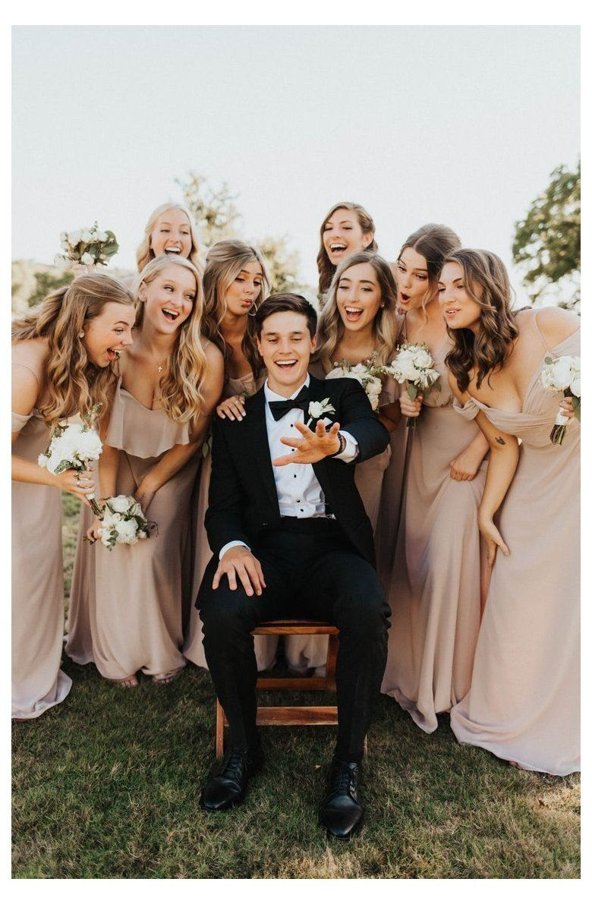
GROUP MEMBERS
182009 – W.B.A.N. Bandara
182022 – A.H.T. Dilshani
182051 – H.M.C.K. Herath
182110 – D.S.W.R. Ranasinghe
182113 – J.A.S.N. Ravihansa
182140 – M.R.F. Rifla
182158 – W.A.M. Jayasundara

Slide 3
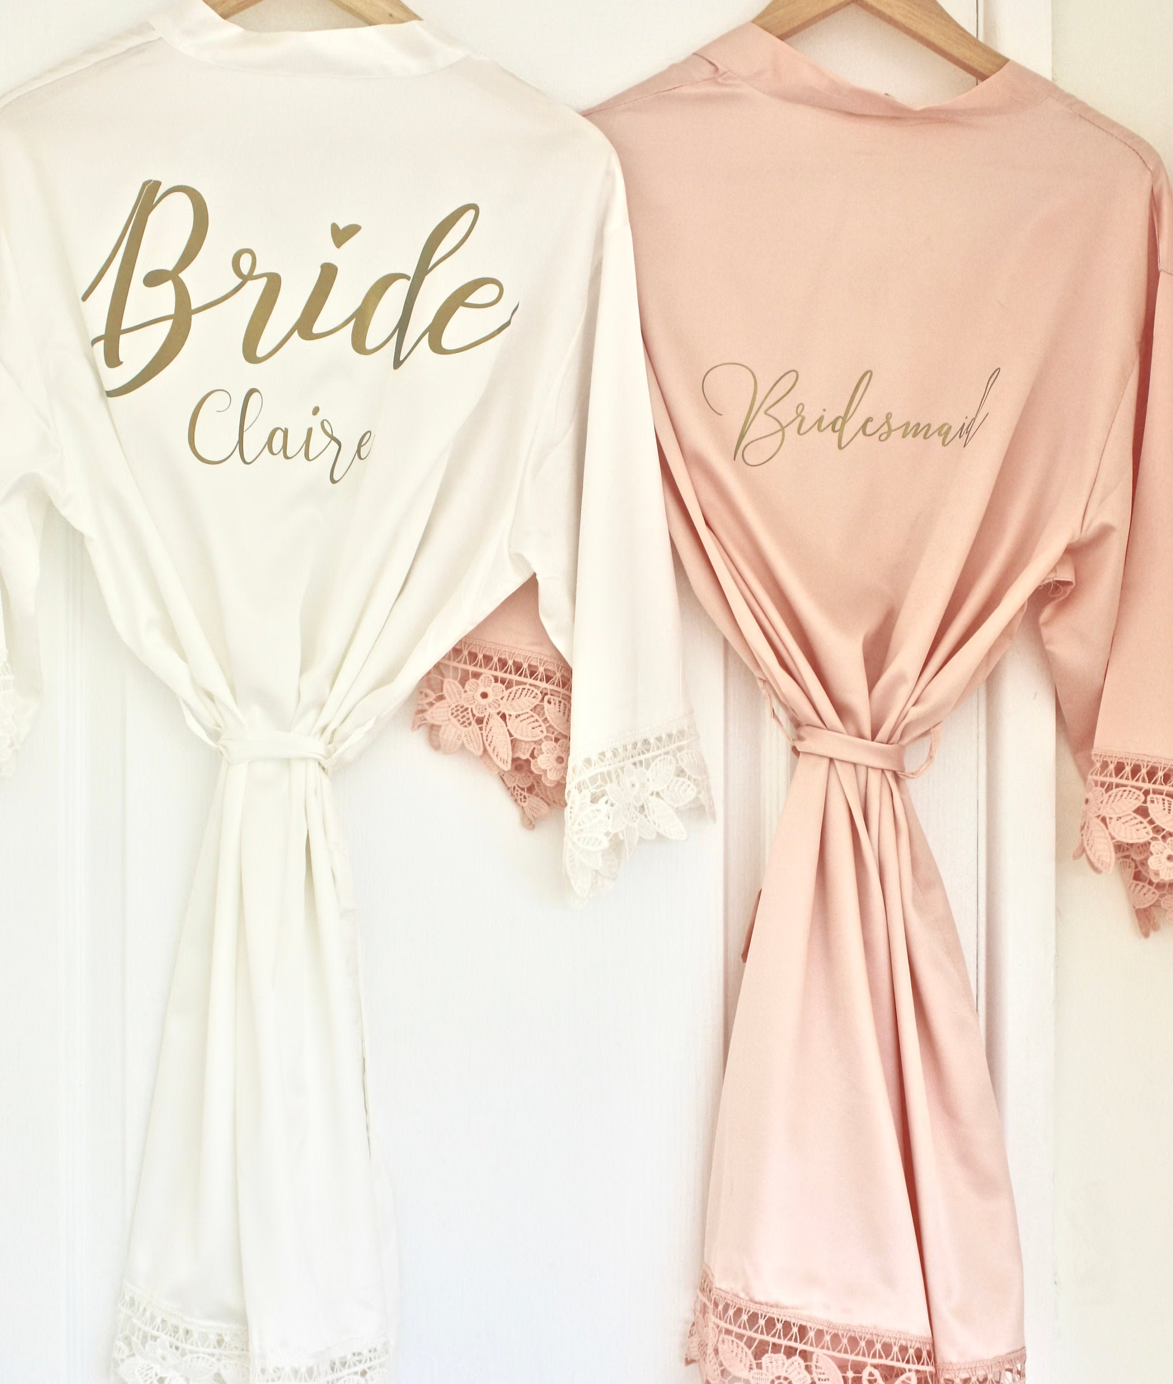
CONTENT
Introduction
Objectives
System Requirement Analysis
Tools & Technology
Issues

Slide 4




INTRODUCTION
Computerized system to plan a client's wedding.
One-stop hub for planning all your events for the wedding.
The system consists of the following categories.
Salon
Photography
Hotels
Decorations
Wedding attire

Slide 5



OBJECTIVES
Reduce the time and transportation cost of the customers.
Customers can compare competitive prices and the quality of various services.
Customers could decide the overall budget easily.

Slide 6


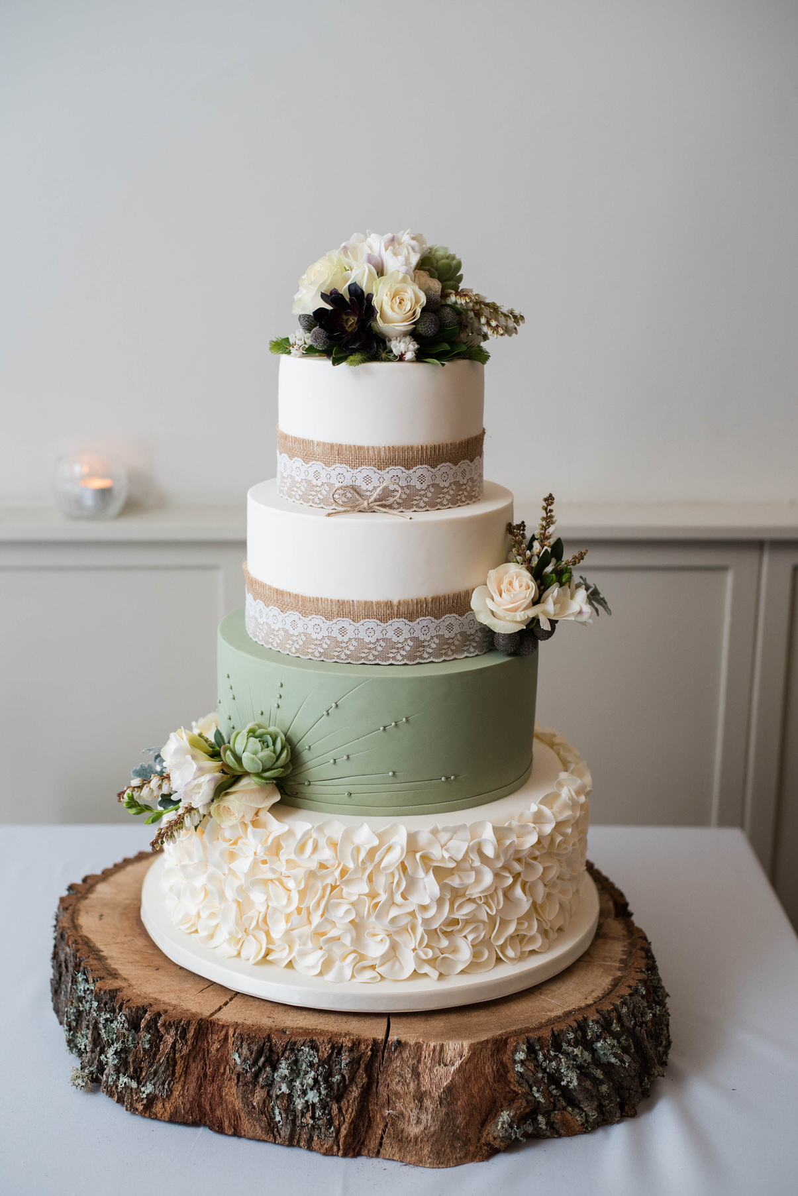
OBJECTIVES
Customers can get ideas about new trends for their weddings.
Service providers could able to market their organizations efficiently.
Customers can select the best match for them from a pool of choices.

Slide 7

FUNCTIONAL REQUIREMENTS
User Login
Appointment handling
Easily accessible
NON - FUNCTIONAL REQUIREMENTS
User friendly interfaces
Accuracy
Usability
Maintainability
SYSTEM REQUIREMENT ANALYSIS
PLAN
Briefly discuss the second process

Slide 8


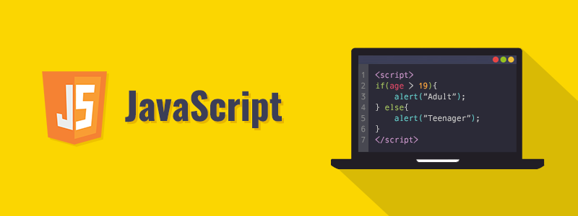

TOOLS & TECHNOLOGIES
Technology: Html, CSS, JavaScript, PHP, MySQL
Text editor: vs code
Database: phpMyAdmin

Slide 9
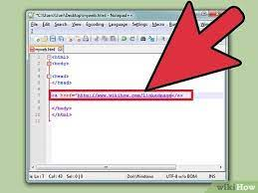
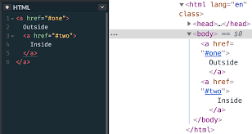
ISSUES
A issue occurred in linking files

Slide 10

THANK
YOU

